Slide 1
Photomicrographs of Plant foods
Plum
Permission to reproduce original photomicrographs used to make this collection may be obtained from
Dr. David O. Norris at
david.norris@colorado.edu

Slide 2
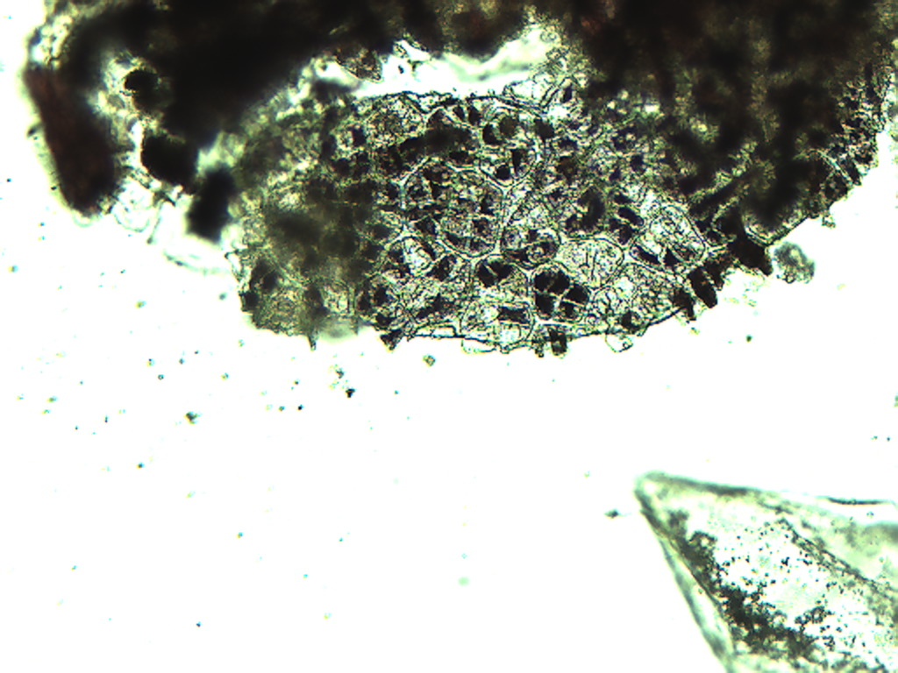
Notes:
396. Prunus domestica L. Plum. Skin epidermis with pigmented cells, 10X.

Slide 3
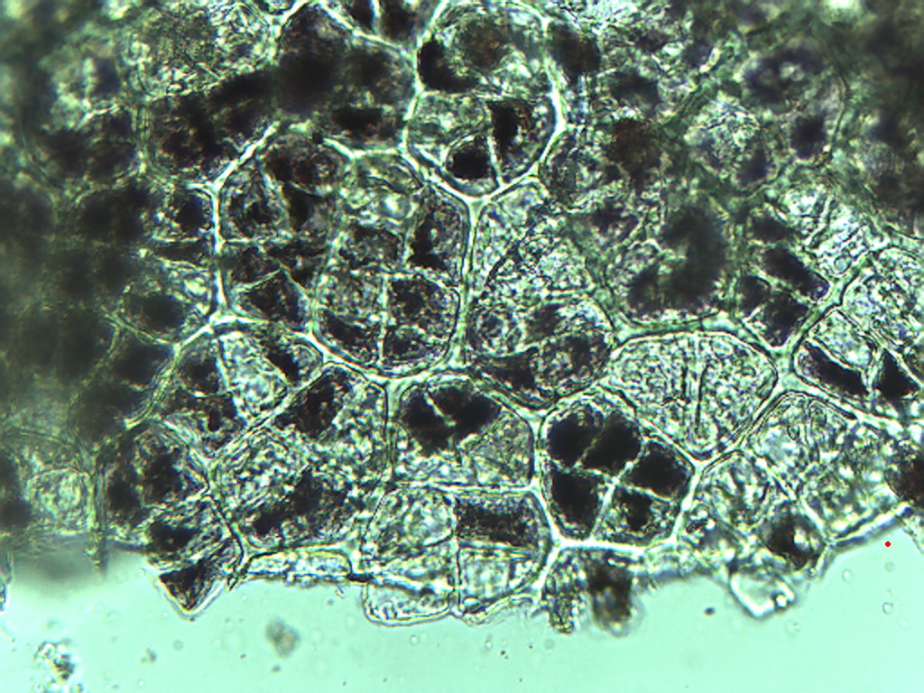
Notes:
397. Plum. Skin epidermis, 25X.

Slide 4
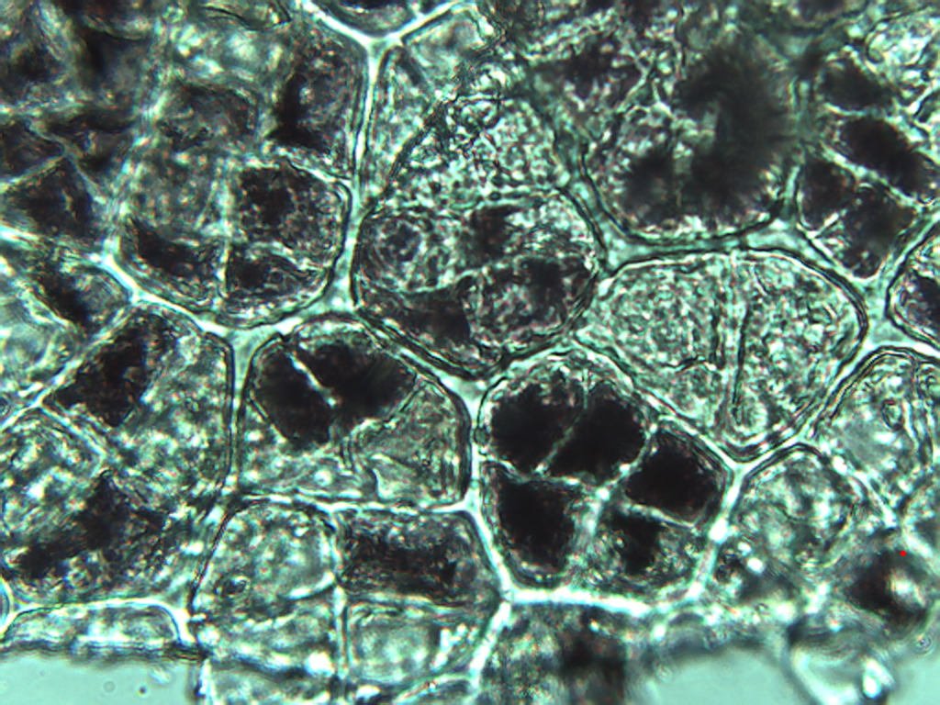
Notes:
398. Plum. Skin epidermis, 40X.

Slide 5
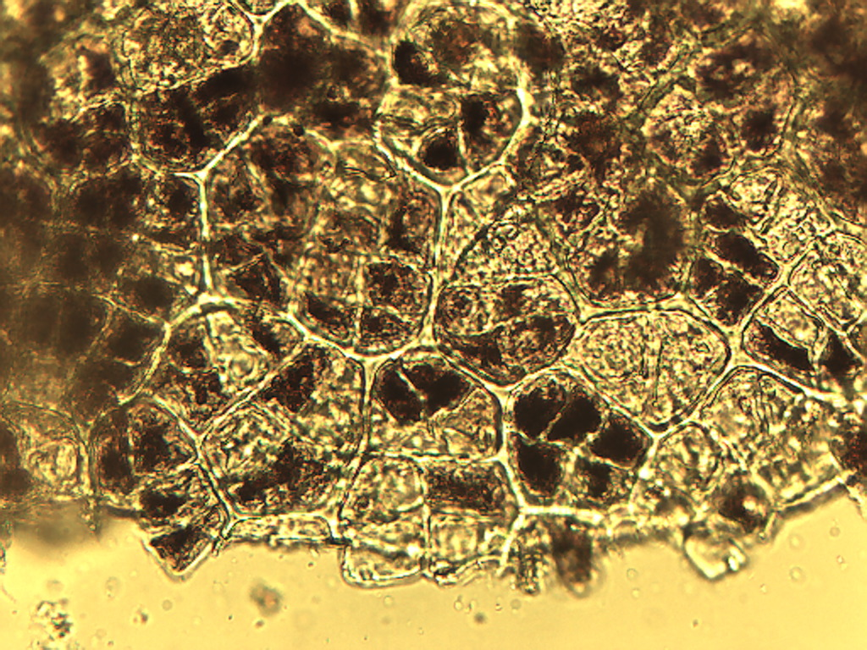
Notes:
399. Plum. Skin, epidermis, 25X. No filter.

Slide 6
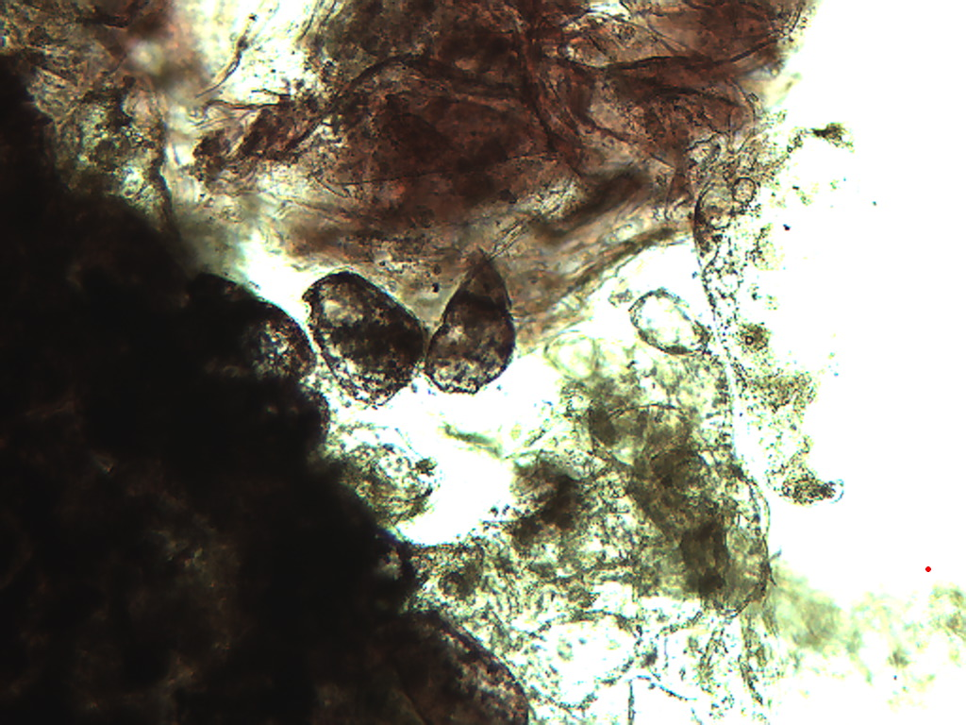
Notes:
400. Plum. Skin, pigmented parenchymal cells, 10X.

Slide 7
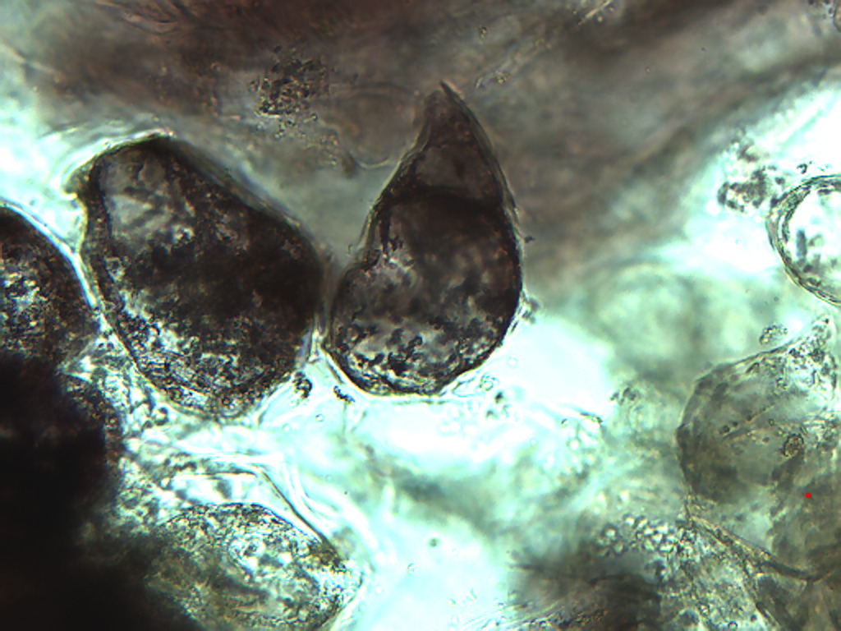
Notes:
401. Plum. Skin, pigmented parenchymal cells, 25X.

Slide 8
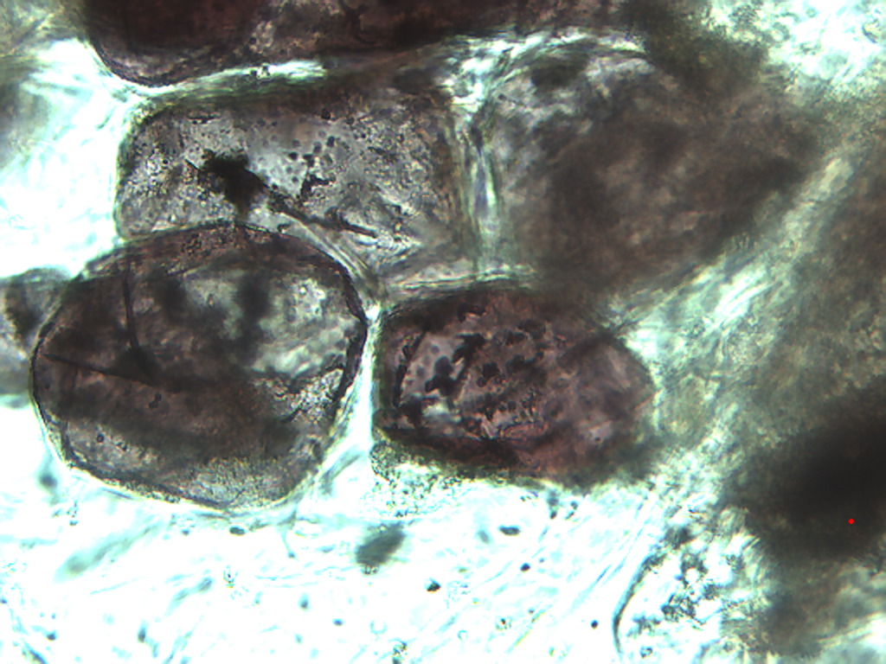
Notes:
402. Plum. Skin, pigmented [parenchymal cells, 25X.

Slide 9
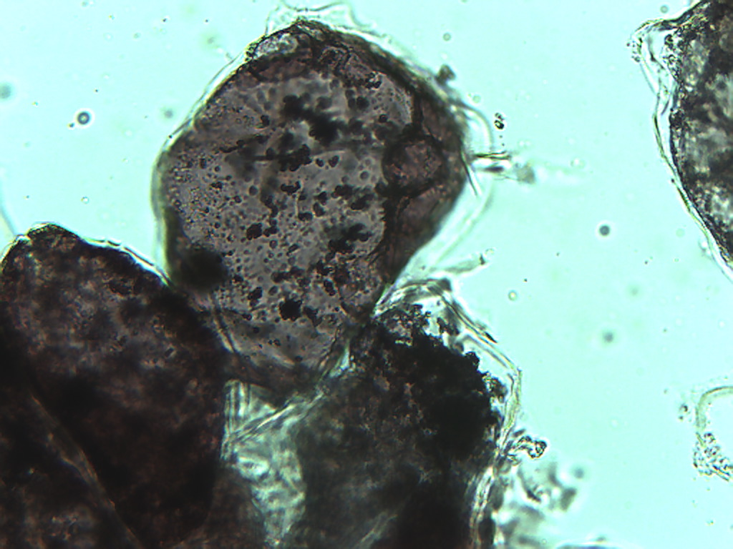
Notes:
403. Plum. Pigmented parenchymal cells, 25X.

Slide 10
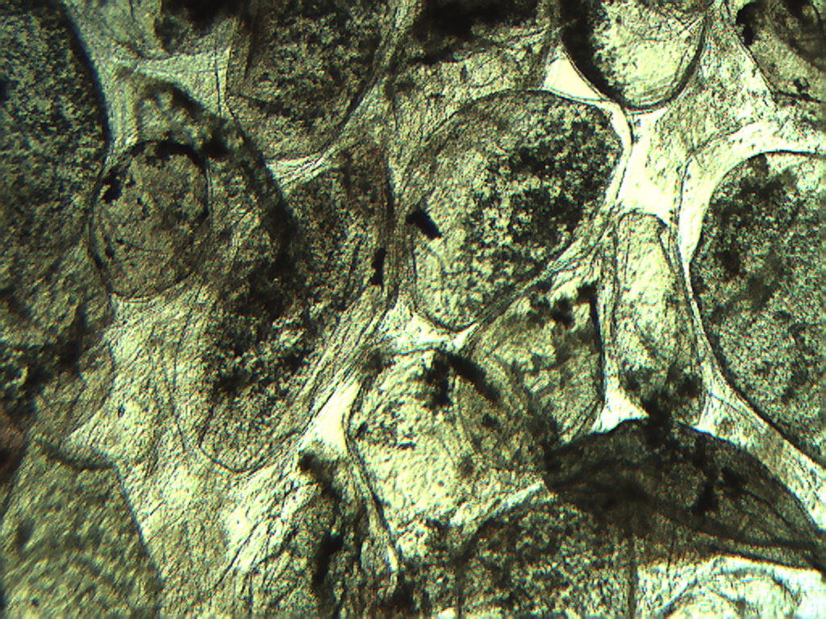
Notes:
404. Plum. Large pulp cells, 4X.

Slide 11
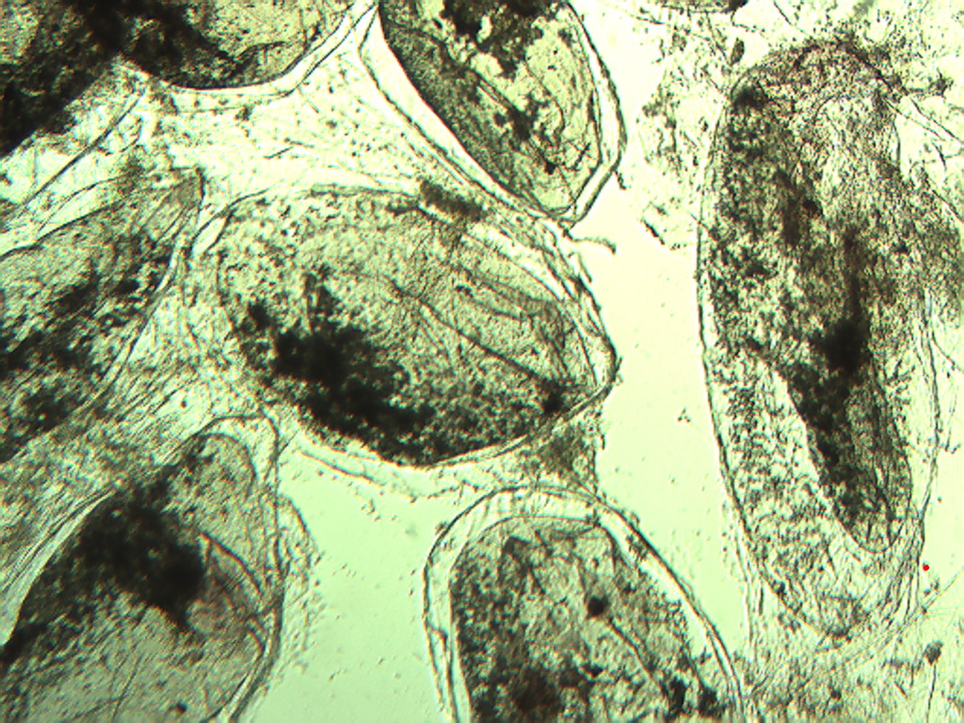
Notes:
405. Plum. Large pulp cells, 4X

Slide 12
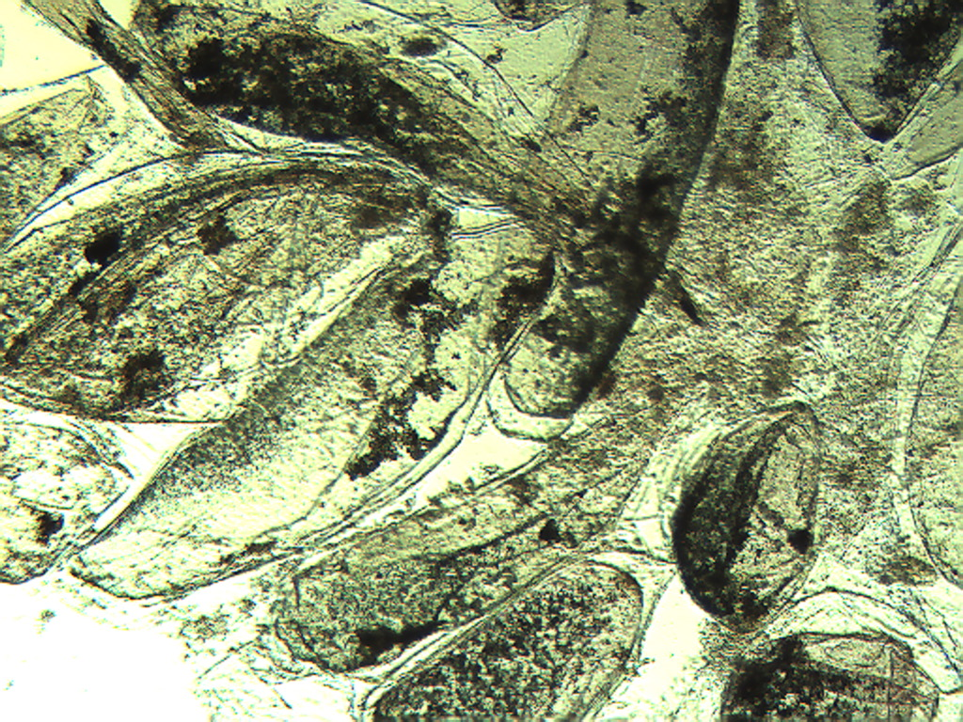
Notes:
406. Plum. Large pulp cells, 4X.

Slide 13
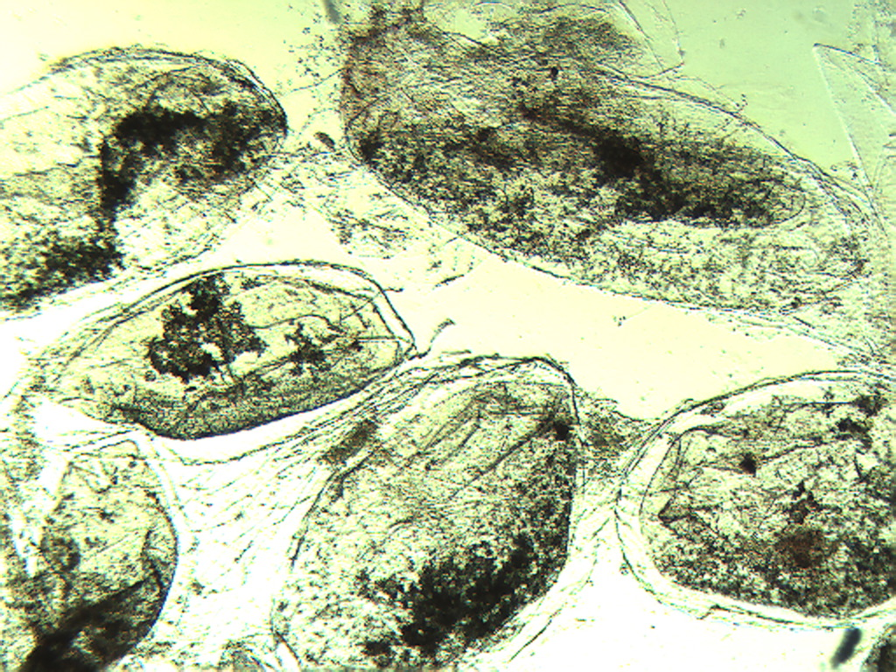
Notes:
407. Plum. Large pulp cells, 4X.

Slide 14
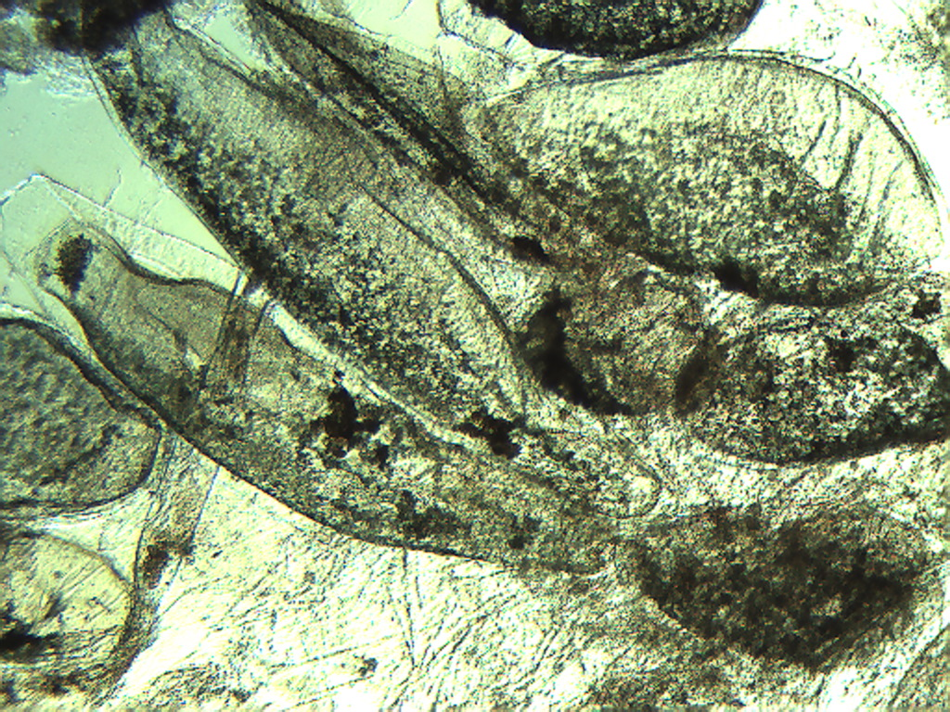
Notes:
408. Plum. Large pulp cells, 4X.

Slide 15
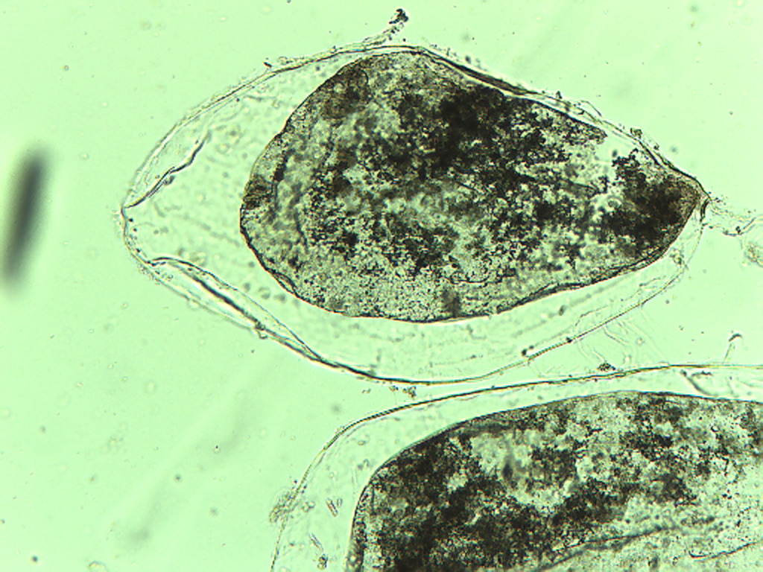
Notes:
409. Plum. Smaller pulp cells, 10X.

Slide 16
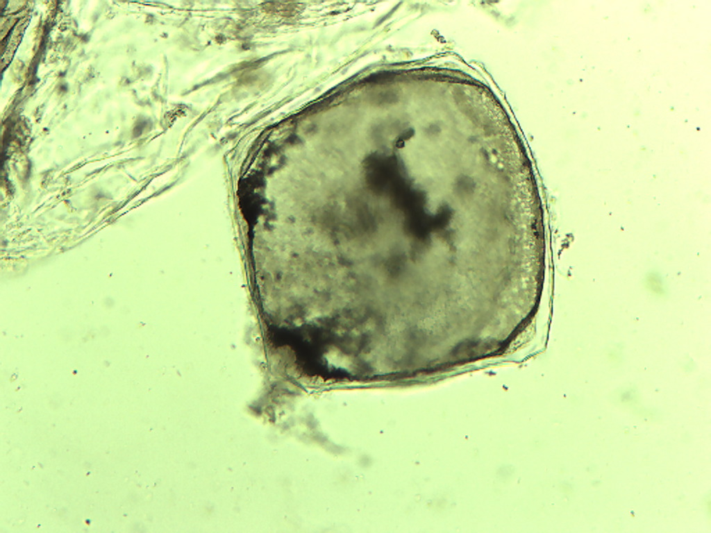
Notes:
410. Plum. Small pulp cell, 10X.

Slide 17
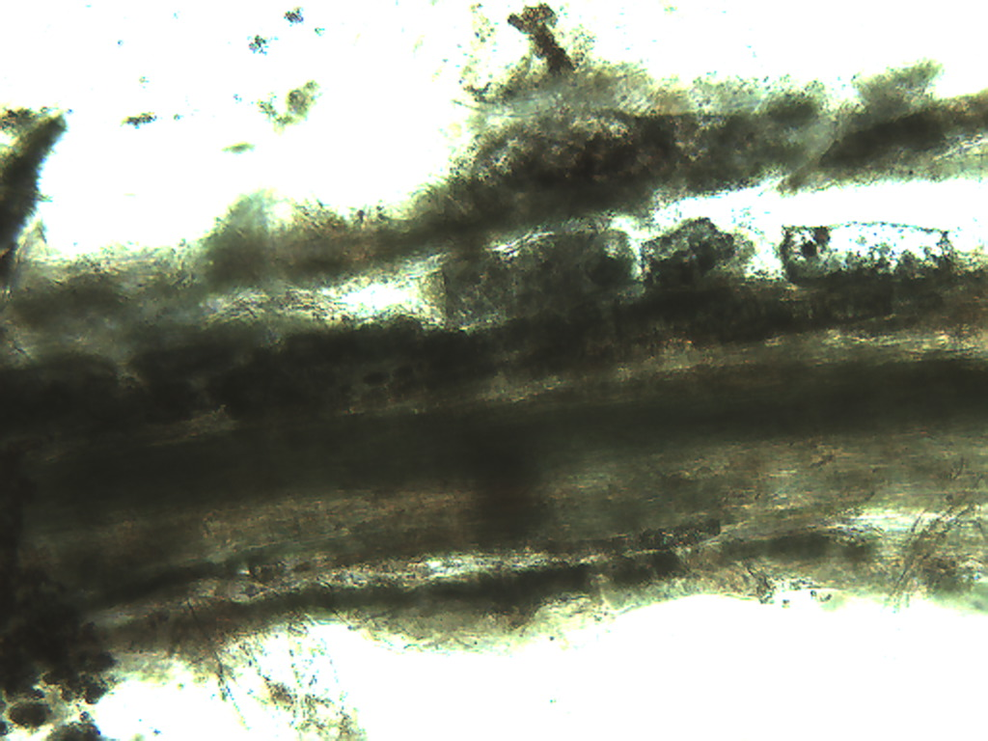
Notes:
411. Plum. Vascular tissue in pulp, 10X.

